Slide 1
Software Quality Engineering
Software Testing Scope, Approaches, Concepts
Lecture 6
Spring 2023

Slide 2
What is Software Testing Scope?
A Testing Scope is a list of product features, product parts, or product-related integrations that must be tested in order to build a reliable assessment of a product’s quality.
The scope of a test defines what areas of a customer's product are supposed to get tested, what functionalities to focus on, what bug types the customer is interested in, and what areas or features should not be tested by any means.

Slide 3
Scope: What it defines?
The Testing Scope doesn’t include details of the testing strategy, the automation approach or the tools that are going to be used. I won’t list who will perform the testing or when it will happen. The document that represents the details above is called the Testing Plan. It answers the questions “Who”, “When”, “Why”:
  who will perform the testing,
  when to perform the testing,
  why to test / not to test specific product parts, etc.
The Testing Scope itself answers the question “What”: what to test.

Slide 4
Example
Let’s take a look at a small example. Imagine we have a feature, ‘a new layout for a site component’. Let’s think about which parts of that feature should be tested in order to conclude whether it meets the expectations or not.
In this example above you will find the different testing types like UI, functional, performance, accessibility. Each product item is defined on a very high level.

Slide 5
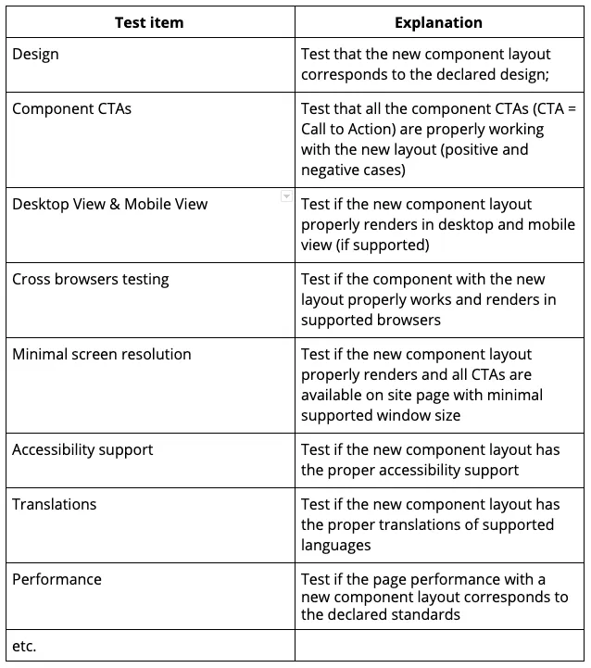
Example

Slide 6
How to find out which testing types to apply?
To answer this question, explore your feature from different angles:
  feature has a UI part — think of adding UI/UX, functional, accessibility, performance testing to your testing scope;
  feature uses an API, it makes sense to test server-side validation and error handling;
  feature reads/writes to a database — security testing helps ensure there won’t be unaccounted DB access for malicious reasons;
  your product has a representation on mobile devices — mobile testing will come in handy.

Slide 7
What should a testing scope level of detail be?
The level of detail of the testing scope should be selected according to the needs of the tester.
For instance, If the testing scope is written only for a QA (for the only QA on the project), the left part from the example above should be enough for that QA to understand the task.
In case if the scope is created for a group of testers that are new to the product, it will be most likely add more explanations and even split each item into subtasks.
It is possible to list the feature parts that won’t be tested in the Testing Scope. Or to consider that everything that is not listed in testing scope (out-of-testing-scope) will be omitted during testing.

Slide 8
Which stakeholders should be aware of the testing scope?
There are several reasons that may incline you to notify some of the stakeholders and ask them to review or approve your testing scope:
  When a feature has parts that for some reason cannot be tested, it’s highly recommended to let the manager and the developer know. It always leads to some risks that should be discussed and accepted;
  When you find the use case scenarios that are not covered in the design or the documentation, it makes sense to raise an issue about it. In my practise designers might forget to add an error screen (general error like 404 or 500 or a specific server-side error);
  Sometimes, when working on the test scope you may find the illogical user scenario or the missing requirements. And again, it’s better to raise this issue at the early stage, rather than after the development is completed.

Slide 9
Few Important Points about Test Scope
The testing scope is a high-level list of product parts that have to be tested in order to gain a reliable assessment of a product’s quality.
To figure out which testing types to apply, explore your product from different angles. Choose the level of details that fits your needs best: think who will perform the testing, how well the executors know the SUT (System Under Testing).
As an additional step, check if your testing scope has to be reviewed by your stakeholders. This helps align the deadlines and clarify all the controversial points.
Finding out the business goal of your product or feature will give you a clue about what to focus on. Talk to the owner of the product, get to know why the company wants this feature and who will be its audience.
And finally, consider delegating some parts of testing to your teammates. Often we are limited in time or human resources, and it’s totally OK to ask for help and collaborate to achieve the one goal — ensure the product’s quality.
Notes:
https://www.ciscopress.com/articles/article.asp?p=1706355&seqNum=2

Slide 10
Levels of Testing
  Component or Unit Testing
  Integration Testing
  System Testing
  Acceptance Testing

Slide 11
Component Testing
Component testing, also known as unit, module and program testing, searches for defects in, and verifies the functioning of software (e.g. modules, programs, objects, classes, etc.) that are separately testable.
Component testing may be done in isolation from the rest of the system depending on the context of the development life cycle and the system. Most often stubs and drivers are used to replace the missing software and simulate the interface between the software components in a simple manner. A stub is called from the software component to be tested; a driver calls a component to be tested.
Component testing may include testing of functionality and specific non-functional characteristics such as resource-behavior (e.g. memory leaks), performance or robustness testing, as well as structural testing (e.g. decision coverage). Test cases are derived from work products such as the software design or the data model.

Slide 12
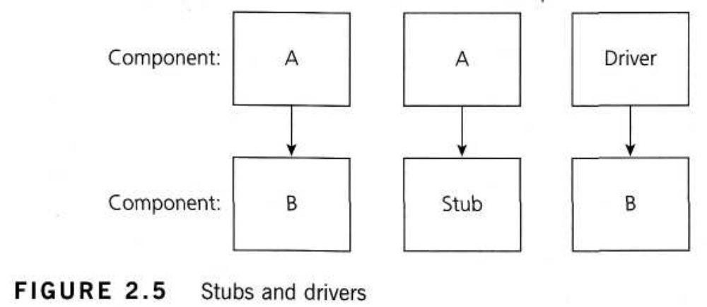
Stubs and Drivers

Slide 13
Stubs and Drivers
The concept of Stubs and Drivers are mostly used in the case of component testing. Component testing may be done in isolation with the rest of the system depending upon the context of the development cycle.
Stubs and drivers are used to replace the missing software and simulate the interface between the software components in a simple manner.
Suppose you have a function (Function A) that calculates the total marks obtained by a student in a particular academic year. Suppose this function derives its values from another function (Function B) which calculates the marks obtained in a particular subject.
You have finished working on Function A and wants to test it. But the problem you face here is that you can't seem to run the Function A without input from Function B; Function B is still under development. In this case, you create a dummy function to act in place of Function B to test your function. This dummy function gets called by another function. Such a dummy is called a Stub.
To understand what a driver is, suppose you have finished Function B and is waiting for Function A to be developed. In this case you create a dummy to call the Function B. This dummy is called the driver.

Slide 14
Stubs and Drivers
Stubs are dummy modules that are always distinguish as "called programs", or you can say that is handle in integration testing (top down approach), it used when sub programs are under construction. Stubs are considered as the dummy modules that always simulate the low level modules.
Drivers are also considered as the form of dummy modules which are always distinguished as "calling programs”, that is handled in bottom up integration testing, it is only used when main programs are under construction. Drivers are considered as the dummy modules that always simulate the high level modules.
For Example we have 3 modules login, home, and user module. Login module is ready and need to test it, but we call functions from home and user (which is not ready). To test at a selective module we write a short dummy piece of a code which simulates home and user, which will return values for Login, this piece of dummy code is always called Stubs and it is used in a top down integration.
Considering the same Example above: If we have Home and User modules get ready and Login module is not ready, and we need to test Home and User modules Which return values from Login module, So to extract the values from Login module We write a Short Piece of Dummy code for login which returns value for home and user, So these pieces of code is always called Drivers and it is used in Bottom Up Integration

Slide 15
Component Testing
Typically, component testing occurs with access to the code being tested and with the support of the development environment, such as a unit test frame-work or debugging tool, and in practice usually involves the programmer who wrote the code. Sometimes, depending on the applicable level of risk, compo-nent testing is carried out by a different programmer thereby introducing inde-pendence. Defects are typically fixed as soon as they are found, without formally recording the incidents found.

Slide 16
Integration testing
Integration testing tests interfaces between components, interactions to different parts of a system such as an operating system, file system and hard-ware or interfaces between systems. Note that integration testing should be differentiated from other integration activities. Integration testing is often carried out by the integrator, but preferably by a specific integration tester or test team.
There may be more than one level of integration testing and it may be carried out on test objects of varying size. For example:
  component integration testing tests the interactions between software components and is done after component testing;
  system integration testing tests the interactions between different systems and may be done after system testing. In this case, the developing organization may control only one side of the interface, so changes may be destabilizing. Business processes implemented as workflows may involve a series of systems that can even run on different platforms.

Slide 17
Integration testing
The greater the scope of integration, the more difficult it becomes to isolate failures to a specific interface, which may lead to an increased risk. This leads to varying approaches to integration testing. One extreme is that all components or systems are integrated simultaneously, after which everything is tested as a whole. This is called 'big-bang' integration testing.

Slide 18
System testing
System testing is concerned with the behavior of the whole system/product as defined by the scope of a development project or product. It may include tests based on risks and/or requirements specification, business processes, use cases, or other high level descriptions of system behavior, interactions with the operating system, and system resources. System testing is most often the final test on behalf of development to verify that the system to be delivered meets the specification and its purpose may be to find as many defects as possible.

Slide 19
System testing
System testing should investigate both functional and non-functional requirements of the system. Typical non-functional tests include performance and reliability. Testers may also need to deal with incomplete or undocumented requirements. System testing of functional requirements starts by using the most appropriate specification-based (black-box) techniques for the aspect of the system to be tested. For example, a decision table may be created for combinations of effects described in business rules. Structure-based (white-box) techniques may also be used to assess the thoroughness of testing elements such as menu dialog structure or web page navigation

Slide 20
Acceptance testing
When the development organization has performed its system test and has corrected all or most defects, the system will be delivered to the user or customer for acceptance testing. The acceptance test should answer questions such as: 'Can the system be released?', 'What, if any, are the outstanding (business) risks?' and 'Has development met their obligations?'. Acceptance testing is most often the responsibility of the user or customer, although other stakeholders may be involved as well. The execution of the acceptance test requires a test environment that is for most aspects, representative of the production environment ('as-if production').
The goal of acceptance testing is to establish confidence in the system, part of the system or specific non-functional characteristics, e.g. usability, of the system. Acceptance testing is most often focused on a validation type of testing, whereby we are trying to determine whether the system is fit for purpose.

Slide 21
Acceptance testing
Finding defects should not be the main focus in acceptance testing. Although it assesses the system's readiness for deployment and use, it is not necessarily the final level of testing. For example, a large-scale system integration test may come after the acceptance of a system.
Acceptance testing may occur at more than just a single level, for example:
A Commercial Off The Shelf (COTS) software product may be acceptance tested when it is installed or integrated.
Acceptance testing of the usability of a component may be done during component testing.
Acceptance testing of a new functional enhancement may come before system testing.

Slide 22
Acceptance testing
The user acceptance test focuses mainly on the functionality thereby validating the fitness-for-use of the system by the business user, while the operational acceptance test (also called production acceptance test) validates whether the system meets the requirements for operation. The user acceptance test is performed by the users and application managers.
The operational acceptance test may include testing of backup/restore, disaster recovery, maintenance tasks and periodic check of security vulnerabilities.

Slide 23
Alpha and Beta Testing
If the system has been developed for the mass market, e.g. commercial off-the-shelf software (COTS), then testing it for individual users or customers is not practical or even possible in some cases.
Feedback is needed from potential or existing users in their market before the software product is put out for sale commercially. Very often this type of system undergoes two stages of acceptance test. The first is called alpha testing. This test takes place at the developer's site. A cross-section of potential users and members of the developer's organization are invited to use the system. Developers observe the users and note problems. Alpha testing may also be carried out by an independent test team.
Beta testing, or field testing, sends the system to a cross-section of users who install it and use it under real-world working conditions. The users send records of incidents with the system to the development organization where the defects are repaired.

